Slide 1
NDNCERT Easy Deployment
Presenter: Siqi Liu,
Muhammad Nuzaihan,
Tianyuan Yu,
Zhiyi Zhang
NDN Hackathon, Oct 18, 2020

Slide 2
NDNCERT v0.3
A automatic certificate managerment server on NDN
Uses various out-of-band identity verification and certificate issuance using NDN
Designed for managing NDN testbed certificate in the beginning, but also can be used for other trust anchors

Slide 3
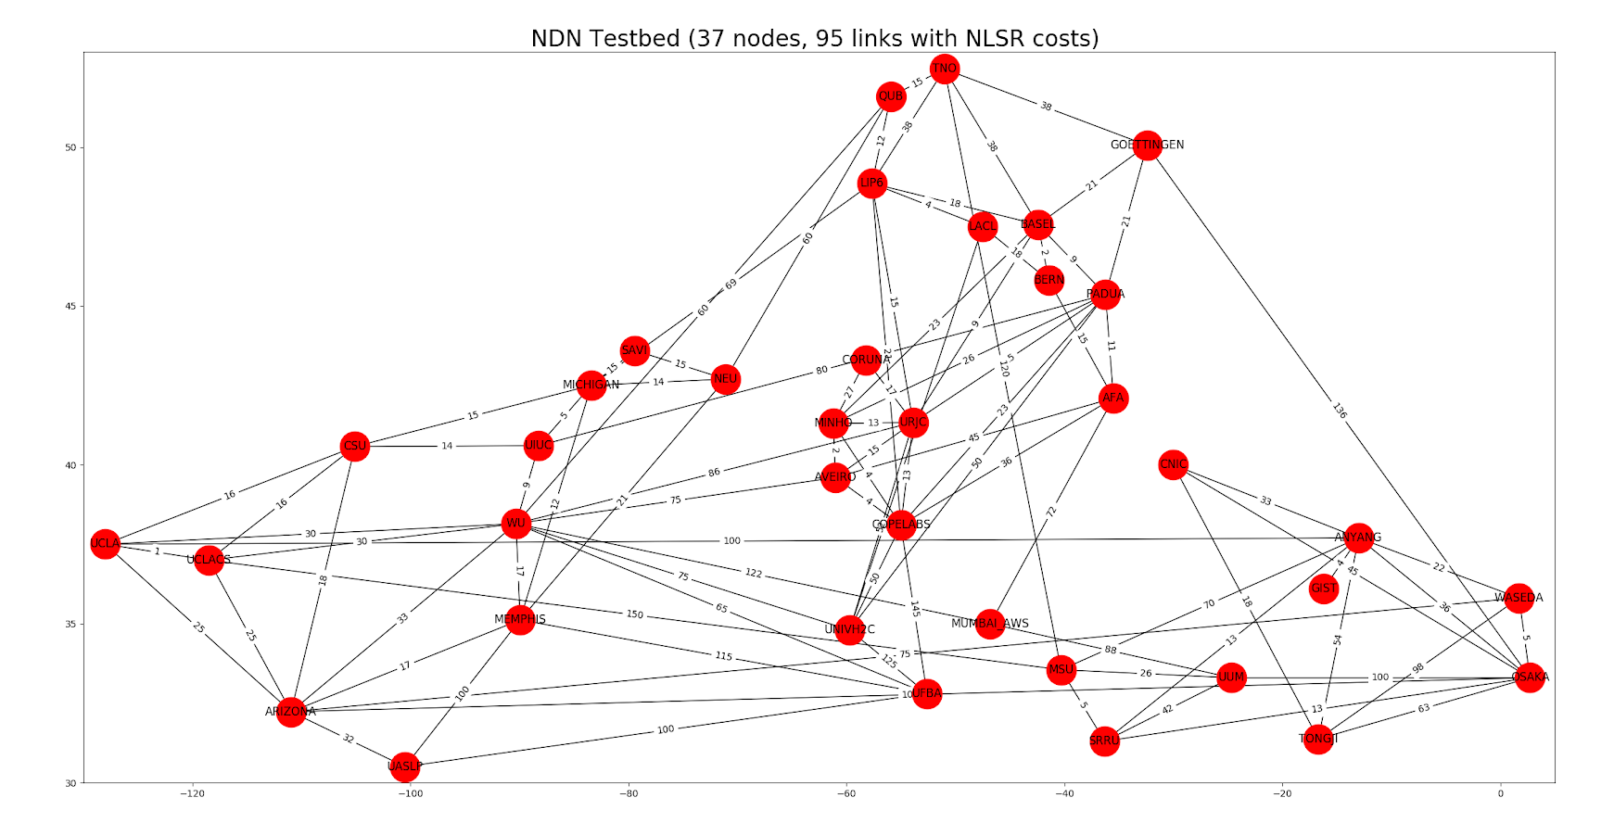
NDN testbed
Two layers of certificate managers
The root certificate manager /ndn for the whole testbed
Multiple participating institutions or sites have their own certificate manager.
Manually set up NDNCERT and write configuration files is time-consuming and error-prone
We need a smooth way to set up NDNCERT on the testbed so as to make things easier for Prof John DeHart

Slide 4
Our Work done in the Hackathon
A bash script that automatics prompts for required parameter and setup the NDNCERT service on each testbed server
An instruction document on how to links the anchors under the trust anchor hierarchy
Also fixed bugs in NDNCERT codebase

Slide 5

Demo

Slide 6
Future work
Utilize Redhat Ansible for NDNCERT deployment
Continue the code review process for NDNCERT v0.3 and deploy it on the NDN Testbed

Slide 7
Thank you

